Slide 1
Computational Physics (Lecture 14)
PHY4061

Slide 2
Linear equations
Many eigenvalue or boundary-value problems are in the form of linear equations
u’’ + d(x)u’ + q(x)u = s(x),
where d(x), q(x), and s(x) are functions of x.
Assume that the boundary conditions are u(0) = u0 and u(1) = u1.
If all d(x), q(x), and s(x) are smooth, we can solve the equation with the shooting method.
How?

Slide 3
an extensive search for the parameter α from f (α) = u_{α}(1) − u1 = 0 is unnecessary in this case
because of the principle of superposition of linear equations
any linear combination of the solutions is also a solution of the equation
We need only two trial solutions uα0 (x) and uα1 (x),
where α0 and α1 are two different parameters.
The correct solution of the equation is given by
u(x) = auα0 (x) + buα1 (x),
where a and b are determined from u(0) = u0 and u(1) = u1. Note that uα0 (0) =uα1 (0) = u(0) = u0.
a + b = 1,
u_{α0} (1)a + u_{α1} (1)b = u1,

Slide 4
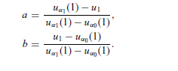
We have:

Slide 5
// An example of solving the boundary-value problem of
// a linear equation via the Runge-Kutta method.
import java.lang.*;
public class LinearDEq {
static final int n = 100, m = 5;
public static void main(String argv[]) {
double y1[] = new double [n+1];
double y2[] = new double [n+1];
double y[] = new double [2];
double h = 1.0/n;
// Find the 1st solution via the Runge-Kutta method
y[1] = 1;
for (int i=0; i<n; ++i) {
double x = h*i;
y = rungeKutta(y, x, h);
y1[i+1] = y[0];
}
// Find the 2nd solution via the Runge-Kutta method
y[0] = 0;
y[1] = 2;
for (int i=0; i<n; ++i) {
double x = h*i;
y = rungeKutta(y, x, h);
y2[i+1] = y[0];
}
// Superpose the two solutions found
double a = (y2[n]-1)/(y2[n]-y1[n]);
double b = (1-y1[n])/(y2[n]-y1[n]);
for (int i=0; i<=n; ++i)
y1[i] = a*y1[i]+b*y2[i];
// Output the result in every m points
for (int i=0; i<=n; i+=m)
System.out.println(y1[i]);
}
public static double[] rungeKutta(double y[],
double t, double dt) {...}
public static double[] g(double y[], double t) {...}
}

Slide 6
Partial differential equations
Partial differential equations in physics
In this chapter, we discuss numerical schemes for solving partial differential equations.
Several types of partial differential equations in physics.
The Poisson equation:∇² Φ(r) = −ρ(r)/ε
for the electrostatic potential Φ (r) at the position r under the given charge distribution ρ(r) is a typical elliptic equation.

Slide 7
The diffusion equation
∂n(r, t)/∂t−∇· [D(r)∇n(r, t)] = S(r, t)
for the concentration n(r, t) at the position r and time t under the given source S(r, t) is a typical parabolic equation. Here D(r) is the diffusion coefficient at the position r.

Slide 8
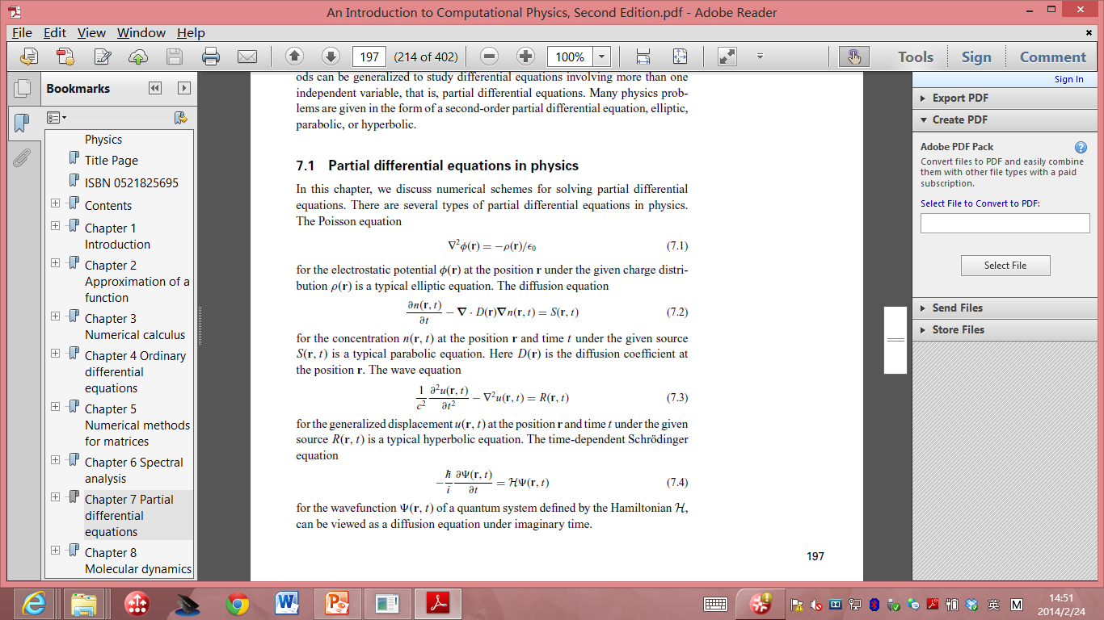
The Wave equation:
for the generalized displacement u(r, t) at the position r and time t under the given source R(r, t) is a typical hyperbolic equation.

Slide 9
The time-dependent Schrodinger equation:
for the wavefunction Ψ(r, t) of a quantum system defined by the Hamiltonian H,
can be viewed as a diffusion equation under imaginary time.

Slide 10
All the equations are linear if the sources and other quantities in the equations are not related to the solutions.
There are also nonlinear equations in physics that rely heavily on numerical solutions.
For example, the equations for fluid dynamics.

Slide 11
Separation of variables
In many cases, using a combination of the separation of variables and a numerical scheme increases the speed of computing and the accuracy of the solution.
The combination of analytic and numerical methods becomes critical in cases where the memory and speed of the available computing resources are limited.

Slide 12
Each variable (time or one of the spatial coordinates) is isolated from the rest, and the solutions of the resulting ordinary differential equations for all the variables are obtained before they are combined into the general solution of the original partial differential equation.
Boundary and initial conditions are then used to determine the unknown parameters left in the solution, which usually appear as the coefficients or eigenvalues.

Slide 13
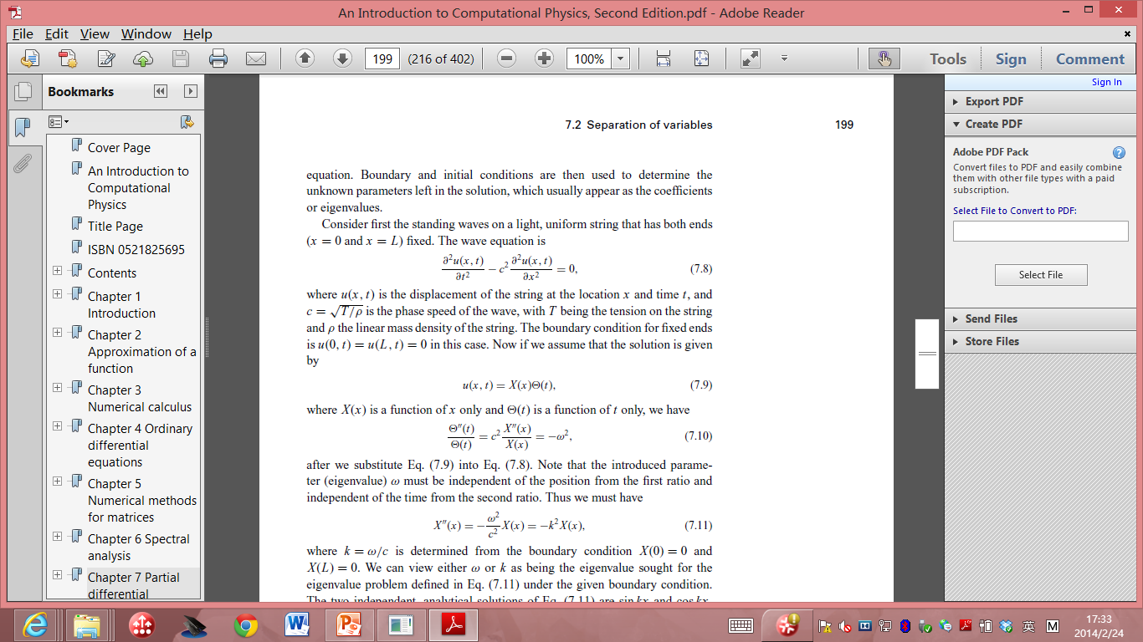
Consider first the standing waves on a light, uniform string that has both ends (x = 0 and x = L) fixed.
The wave equation is
where u(x, t) is the displacement of the string at the location x and time t, and
c =√(T/ρ) is the phase speed of the wave, with T being the tension on the string
and ρ the linear mass density of the string.

Slide 14
The boundary condition for fixed ends is u(0, t) = u(L, t) = 0 in this case.
If we assume that the solution is given by u(x, t) = X(x)Θ(t),

Slide 15
Note that the introduced parameter (eigenvalue) ω must be independent of the position from the first ratio and independent of the time from the second ratio.
we must have
where k = ω/c is determined from the boundary condition X(0) = 0 and
X(L) = 0.

Slide 16
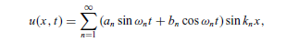
We can view either ω or k as being the eigenvalue sought for the eigenvalue problem under the given boundary condition.
The two independent, analytical solutions are sin kx and cos kx.
Then we have X(x) = A sin kx + B cos kx.
From the boundary condition X(0) = 0, we must have B = 0; from X(L) = 0,
we must have k_{n} = nπ/L
with n = 1, 2, . . . ,∞.
Using this k_{n} in the equation for Θ(t), we obtain Θ(t) = C sin ω_{n} t + D cos ω_{n} t,
With ω_{n} = ck_{n} = nπc/L
Combining the solutions for X(x) and Θ(t), we obtain the general solution
where a_{n} and b_{n} are two sets of parameters that are determined by the initial displacement u(x, 0) = u₀(x) and the initial velocity ∂u(x, t)/∂t = v0(x) when t=0.

Slide 17
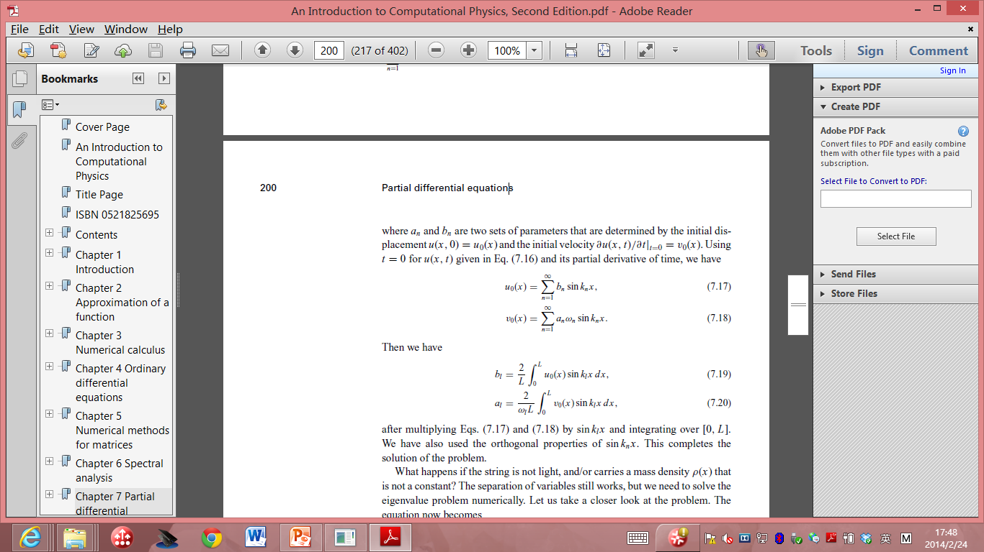
Using t = 0 for u(x, t) and its partial derivative of time, we have:

Slide 18
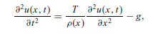
What happens if the string is not light, and/or carries a mass density ρ(x) that is not a constant?
This is an inhomogeneous equation. We can solve it with a general solution of the homogeneous equation u_{h}(x, t) (with g = 0) and a particular solution u_{p}(x, t) of the inhomogeneous equation.
g = 9.80 m/s^2 is the magnitude of the gravitational acceleration
T: the tension on the string

Slide 19

the solution of the homogeneous equation. Still separate t from x by taking u_{h}(x, t) = X(x)Θ(t); then we have
can be solved as an eigenvalue problem in ODE

Slide 20
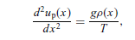
For the particular solution of the inhomogeneous equation
we can simplify the problem by considering the static case, that is, u_{p}(x, t) = u_{p}(x).
A linear equation set if we discretize the second-order derivative involved. This equation determines the shape of the string when it is in equilibrium.

Slide 21
After we obtain the general solution u_{h}(x, t) of the homogeneous equation
and a particular solution of the inhomogeneous equation, u_{p}(x) from the above static equation,
we have the general solution of the inhomogeneous equation as :
u(x, t) = u_{h}(x, t) + u_{p}(x, t).
The initial displacement u₀(x) and initial velocity v₀(x) are still needed to determined the remaining parameters in the general solution above.

Slide 22
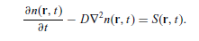
This procedure of separating variables can also be applied to higher dimensional systems.
The diffusion equation in an isotropic, three dimensional, and infinite space, with a time-dependent source and a zero initial value
The diffusion equation under a time-dependent source and a constant diffusion coefficient is given by

Slide 23
The initial value n(r, 0) = 0 will be considered first.
t = 0 in this case can be viewed as the moment of the introduction of the source.
we can view the source as an infinite number of impulsive sources, each within a time interval dτ , given by S(r, τ)δ(t − τ )dτ .
This way of treating the source is called the impulse method.

Slide 24
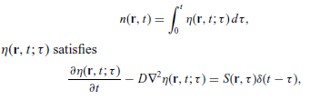
The solution n(r, t) is then the superposition of the solution in each time interval dτ , with
with η(r, 0; τ ) = 0.

Slide 25
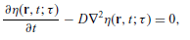
The impulse equation above is equivalent to a homogeneous equation:
with the initial condition η(r, τ; τ ) = S(r, τ).
we have transformed the Original inhomogeneous equation with a zero initial value into an integral of a function that is a solution of a homogeneous equation with a nonzero initial value!

Slide 26
We can generally write the solution of the inhomogeneous equation as the sum of a solution of the corresponding homogeneous equation and a particular solution of the inhomogeneous equation with the given initial condition satisfied.
So if we find a way to solve the corresponding homogeneous equation with a nonzero initial value, we find the solution of the general problem!

Slide 27
the separation of variables for a homogeneous diffusion equation with a nonzero initial value.
Assume that the space is an isotropic, three-dimensional, and infinite space to simplify our discussion.
Suppress the parameter τ to simplify our notation.

Slide 28
The solution of η(r, t) = η(r, t; τ ) is : η(r, t) = X(r)Θ(t),
where X(r) is a function of r only and Θ(t) is a function of t only.
Substitute this assumed solution into the equation,
we have X(r) Θ(t) − D Θ(t)∇² X(r) = 0,
Θ’(t)/D Θ(t) =∇² X(r)/X(r)= −k²,
where k = |k| is an introduced parameter (eigenvalue) that will be determined later.

Slide 29
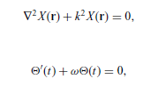
we have two separate equations:

Slide 30
The spatial equation is now a standard eigenvalue problem with k² being the eigenvalue to be determined by the specific boundary condition.
assumed that the space is isotropic, three-dimensional, and infinite, the solution is given by plane waves with
X(r) = C exp(ik·r),
C is a general constant.

Slide 31
Similarly, the time-dependent equation for Θ(t) is a standard initial-value problem with the solution.
Θ(t) = B exp(−ω(t−τ )),
ω = Dk²
B is a coefficient to be determined by the initial condition

Slide 32
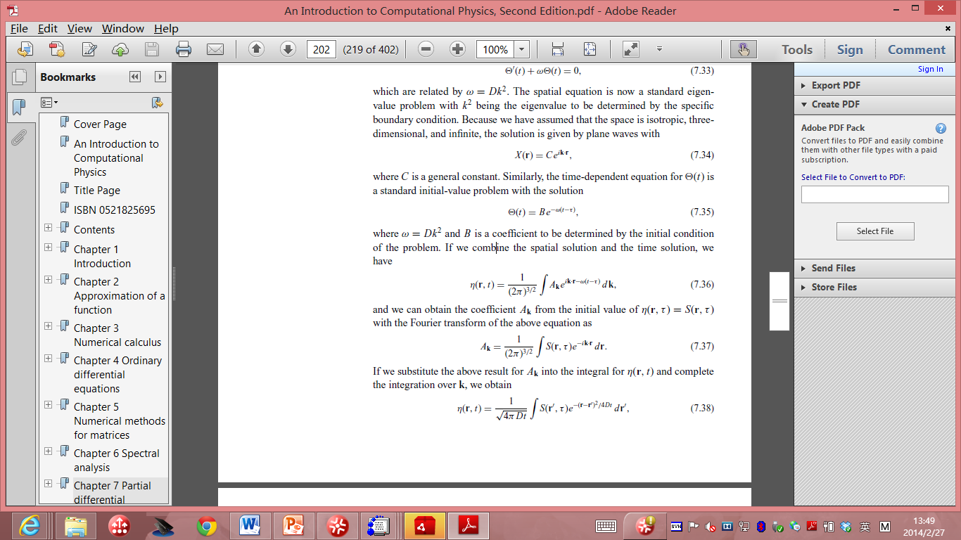
combine the spatial solution and the time solution
we can obtain the coefficient A_{k} from the initial value of η(r, τ) = S(r, τ) with the Fourier transform of the above equation as

Slide 33
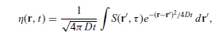
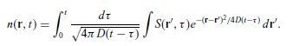
we substitute the above result for A_{k} into the integral for η(r, t) and complete the integration over k, we obtain
substituted into the integral expression of n(r, t):
One question here, how to solve it for finite boundaries?

Slide 34
This integral can be evaluated numerically if the form of S(r, t) is given.
if the space is not infinite but confined by some boundary, the solution will be in a different but similar form, because the idea of the Fourier transform is quite general in the sense of the spatial eigenstates.
In most cases, the spatial eigenstates form an orthogonal basis set which can be used for a general Fourier transform

